Slide 1

Breast Cancer Classification Using Machine Learning

Slide 2




Project Overview & Dataset
Team Members
Dataset Info
Dataset: Breast Cancer Wisconsin(Kaggle)
Samples: 569
Features: 31(1 target)
Target: Diagnosis (M/B)
Classes: M(Malignant)
B(Benign)
Vassia Galanopoulou
Vasiliki Nterkou
Angeliki Triantafyllou

Slide 3
Exploratory Data Analysis (EDA) (1/2)
1
Dataset is clean (no missing values)
Removed Duplicate Records
Removed non-informative columns
Slight class imbalance
Benign: 357
Malignant: 212
2
3
4

Slide 4
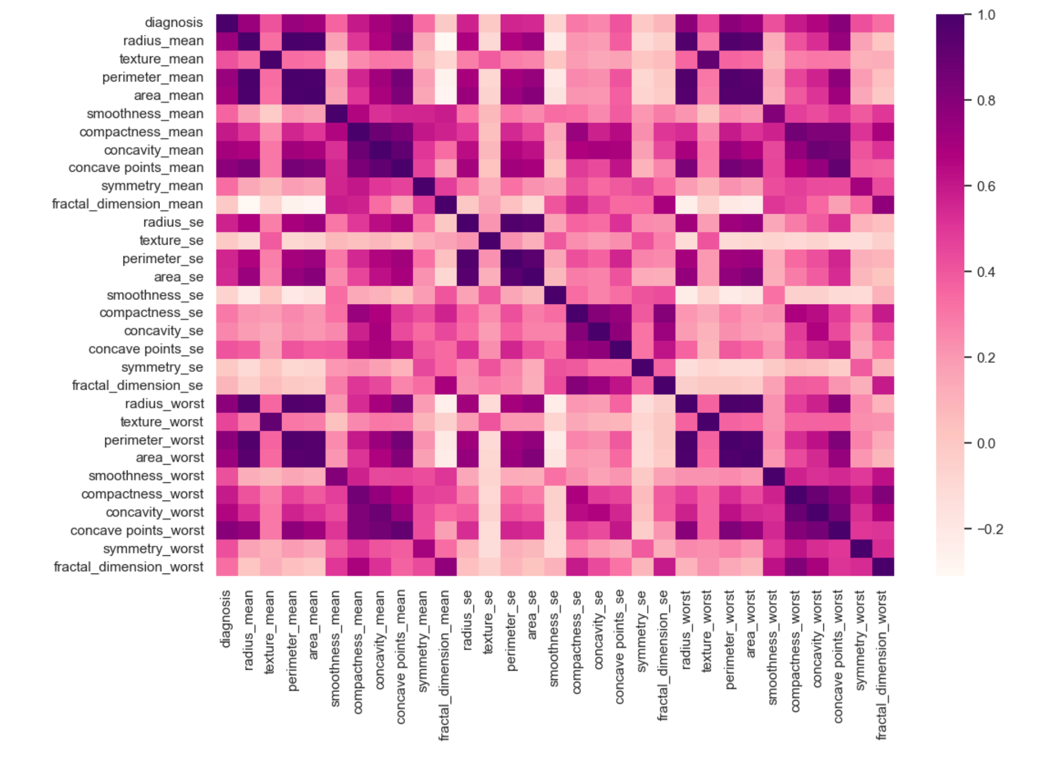
Exploratory Data Analysis (EDA) (2/2)
Strong correlations among geometric features (radius, perimeter, area)
1

Slide 5
Evaluation Metrics
Recall
Precision
Of all malignant tumors, how many our model correctly detect.
Of all cases predicted malignant, how many really are malignant?
Overall proportion of correct predictions.
Accuracy
High Recall :
We catch almost all malignant tumors.
High Precision: few false alarms

Slide 6
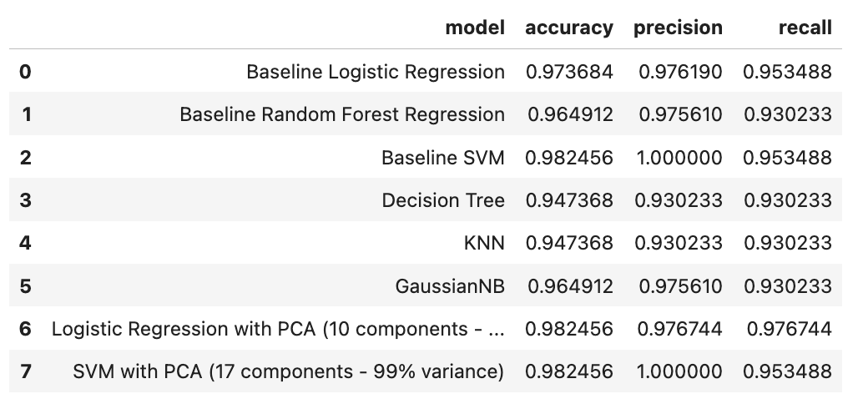
Model Performance Comparison(1/2)

Slide 7
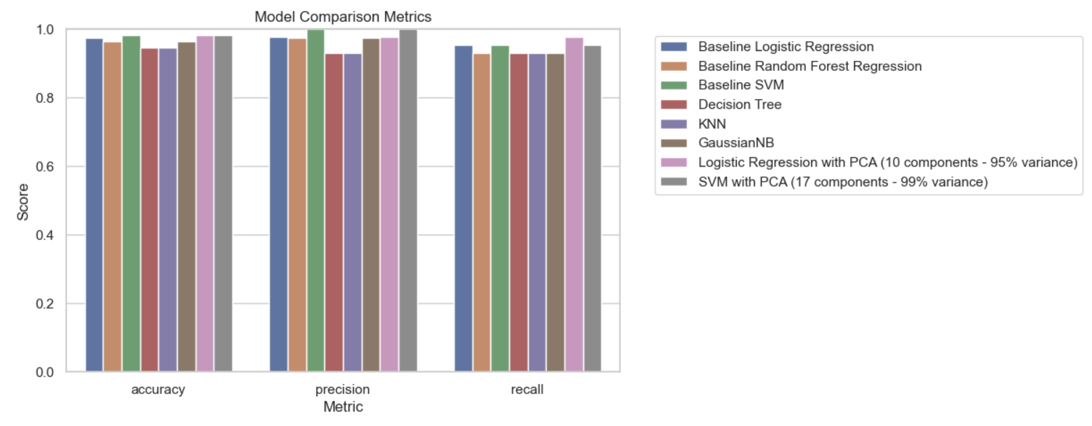
Model Performance Comparison(2/2)

Slide 8
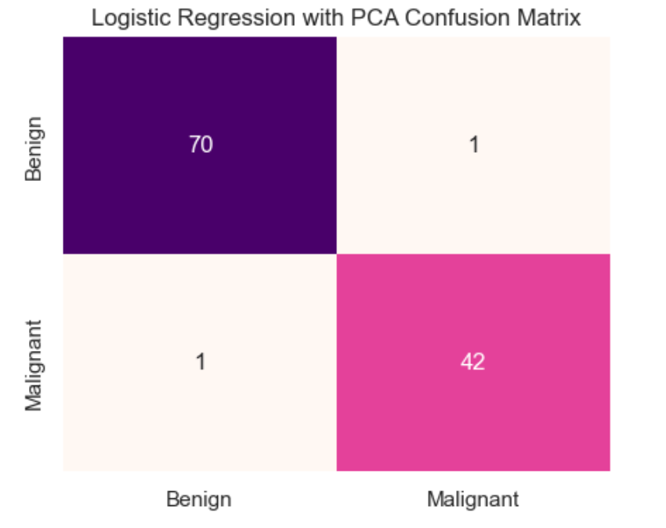
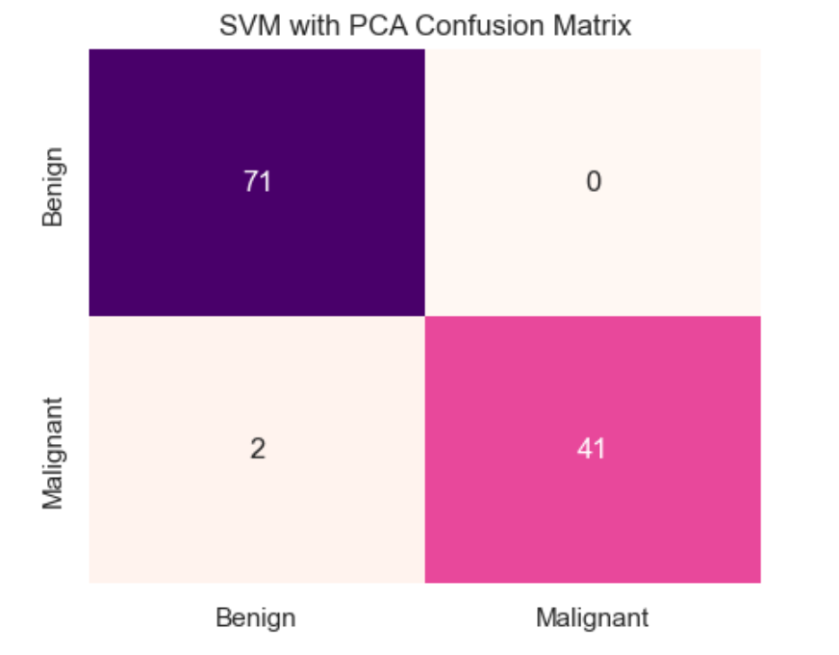

Best Model Analysis
TN
FP
TN
FP
FN
TP
FN
TP
True Negative (TN): Model predicts benign → actually benign (correct prediction)
False Negative (FN): Model predicts benign → actually malignant (dangerous mistake)
False Positive (FP): Model predicts malignant → actually benign
True Positive (TP): Model predicts malignant → actually malignant (correct prediction)

Slide 9
Thank you.

